Slide 1
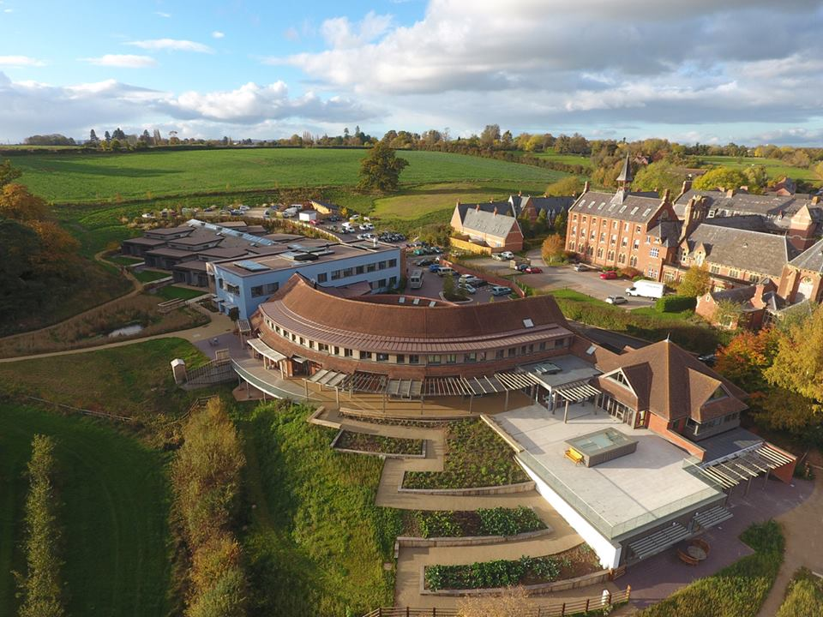
How to arrive
Dr Ray Owen
Consultant Clinical Psychologist, health Psychologist
Wye valley nhs trust, Herefordshire, UK

Slide 2
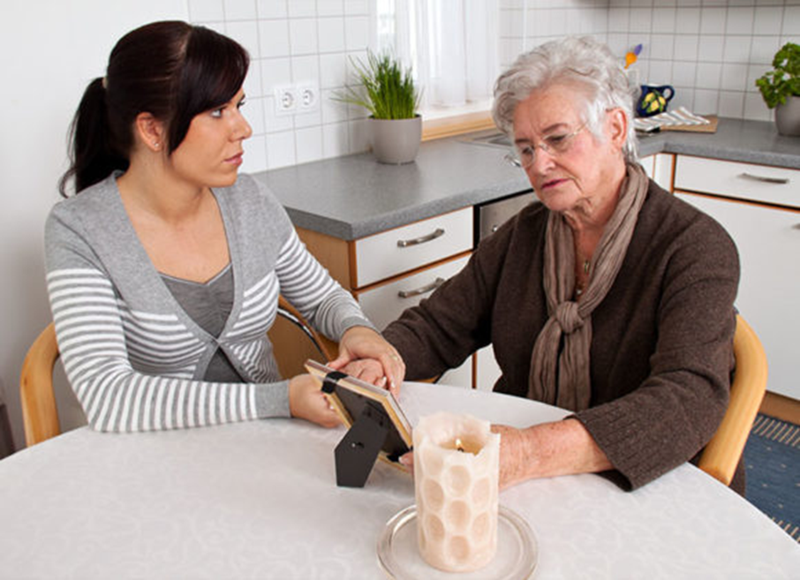
“I don’t think you can live independently any more”
“I have some bad news for you..”
“The test results are bad”
“We made a mistake”

Slide 3
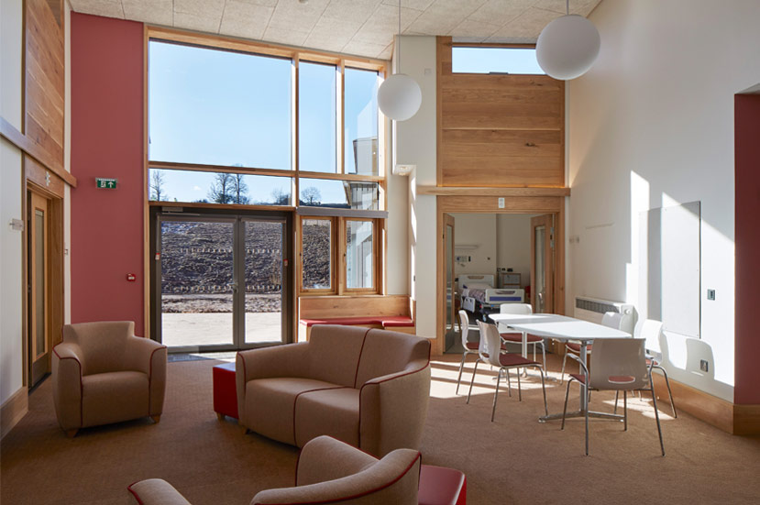
This is too sad – what if I cry?
Her anger scares me
I don’t want to do this
He irritates me
I’ve a hundred things on my mind – can’t focus

Slide 4
“WE HAVE TO TALK”
“I’m resigning”
“Someone has made a complaint about you”
“Mum, Dad; there’s something I have to tell you..”
“Do you want to go on a date?”
“You know Granny has been very poorly..”

Slide 5
This is too sad – what if I cry?
Her anger scares me
I don’t want to do this
He irritates me
I’ve a hundred things on my mind – can’t focus

Slide 6
What gets in the way?
Distraction by other events
Focussing on the past, worrying about the future

Slide 7
What gets in the way?
Distraction by other events
Focussing on the past, worrying about the future
Losing touch with valued goals within the interaction
Losing touch with who you want to be

Slide 8
What gets in the way?
Distraction by other events
Focussing on the past, worrying about the future
Feeling really bad
being distracted by it
Trying to get of it
Our mind tells us Feeling bad = something going wrong
For difficult conversations, Feeling bad can = facing the important things
Losing touch with valued goals within the interaction
Losing touch with who you want to be

Slide 9
What gets in the way?
Distraction by other events
Focussing on the past, worrying about the future
Feeling really bad
being distracted by it
Trying to get of it
Our mind tells us Feeling bad = something going wrong
For difficult conversations, Feeling bad can = facing the important things
Losing touch with valued goals within the interaction
Losing touch with who you want to be

Slide 10
Don’t just walk in & hope for the best..
ARRIVE

Slide 11
Come into this moment

Slide 12
Set your intention

Slide 13
Connect to your values

Slide 14
Engage your willingness

Slide 15
Think of a difficult conversation you’ve had
- Put yourself back there, 30 secs before walk in

Slide 16
Come into this moment Set your intention Connect to your values Engage your willingness

Slide 17
Come into this moment Set your intention Connect to your values Engage your willingness

Slide 18
Come into this moment Set your intention Connect to your values Engage your willingness

Slide 19
Come into this moment Set your intention Connect to your values Engage your willingness

Slide 20
Now go out and use it…
Ask a question in workshop
Volunteer for a role-play
Start a conversation with a stranger
Introduce yourself to someone whose work has helped you
Do a Folly
Ask someone to duet on karaoke
Put yourself forward for a committee / chapter role

